Slide 1
MUSIC RECOMMENDER SYSTEM
TEAM 3
Devesh Kandpal
Priyesh Kaushik
Anindita Chakraborti

Slide 2
INTRODUCTION
For this project, we experimented, designed and implemented a song recommendation system.
Our primary aim was to find correlations between users and between songs to provide recommendation to users with songs that they would prefer to listen to.

Slide 3
FRAMEWORKS/ TECHNOLOGIES USED
Scala
Apache Spark - Spark SQL - Spark Streaming - Spark MLlib
Play Framework
Apache Kafka
Akka Actors
MongoDB
Angular2
NodeJS

Slide 4
DETAILS ABOUT THE DATASET
Million song dataset – We made use of approximately 5% of the total dataset which amounts to about 9 GB worth data.
MusicXMatch – We made use of lyrical content of approximately 237,000 songs which are mapped to million songs dataset using Track ID.
Last.fm – We made use of approximately 500,000 soundtracks that has at least one tag.
Echo Nest taste profile subset – We made use of music taste profile of approximately 500,000 users.
Reference URL: https://labrosa.ee.columbia.edu/millionsong/

Slide 5
DETAILS ABOUT THE DATASET
Million Song Unique Tracks Dataset This dataset consists of Track ID, Song ID, Artist ID and Song Name. Sample data:
TRAAAAW128F429D538<SEP>SOMZWCG12A8C13C480<SEP>Casual<SEP>I Didn't Mean To
Echo Nest dataset This dataset consists of information about User, Song Information like song ID and the number of times the song has been played. Sample data: b80344d063b5ccb3212f76538f3d9e43d87dca9e TRAAAAW128F429D538 1
MusixMatch dataset We divided this dataset into two parts: - The first part is basically a dictionary which has two columns: words used in the song and their index, which is their unique identifier. Sample data: i,the,you,to,and,a,me,it,not,in,my,is,of,your,that,do,on,are,we,am,will
- The second part consists of Song ID, Track ID, Word ID and Count. Sample data: TRAAAED128E0783FAB,2516445,1:28,2:15,3:2,4:12,5:22,6:2,7:2,8:4,9:2,10:1,11:20,12:3,13:1,15:7,16:2,17:1,18:2,20:8,21:13,23:6,25:4,26:3,27:11,28:9,30:4,31:1,34:1,35:3,36:1,39:6

Slide 6
USE CASES
Cold start user – When a new user uses the system with no prior information on user’s taste preference. We have tackled this problem by clustering users that have similar taste in artists. New user provides bare minimum information so that we can classify this user into one of the cluster groups. We use ALS rating algorithm for collaborative filtering to recommend artists for this new user.
Recommend artist for existing users.
Recommend products from users who listen to the current artist you are listening to.
Recommend songs based on similarity in lyrics.

Slide 7
SPARK MLLIB
We made use of Spark Mllib extensively to accurately predict our results.
The main tools that we made use of are: - ML Algorithms: Common algorithms like clustering and collaborative filtering - Featurization: Feature extraction, transformation - Persistence: Saving and loading algorithms and models.
We have also mad use of Stanford OpenNLP for lyrical content analysis.

Slide 8
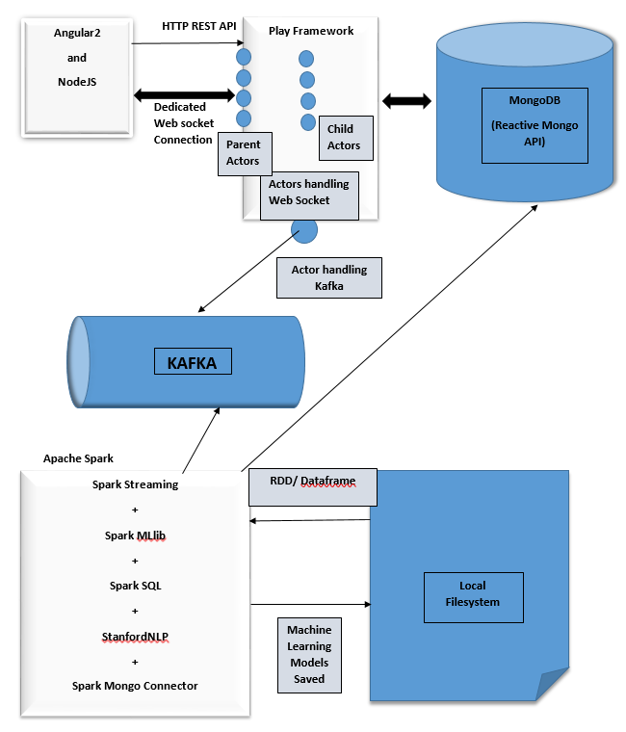
ARCHITECTURE

Slide 9
Acceptance Criteria
We should be able to generate relevant real time recommendations on UI screen within 2 minutes. (Recommendations are populated on the UI Screen in 5 seconds.)
We should be able to serve this application in a 2 or more users environment without having any interference between the users. (Load testing is ongoing.)
We would be showcasing approximately 70% precision and accuracy of our recommendation engine by comparing recommendations by Last.fm. (Implemented successfully.)

Slide 10
THANK YOU!

